Slide 1
Unit 1: Concepts of motion
Section 1.4-1.5
Velocity, Linear Acceleration

Slide 2
Average speed
Average speed = $\frac{distance traveled }{time interval}$ = $\frac{d}{⍙t}$
What is your average speed mph if you drive 20 miles in 15 minutes?

Slide 3
Average velocity
Average speed lacks information we need for the science of motion, particularly directional information.
Average velocity is better because it uses displacement instead of just distance
V_{avg} = $\frac{⍙r}{⍙t}$
Speed is just “how fast”…ex: 20 mph
Velocity is “how fast and in which direction”…ex: 20 mph, north

Slide 4
Motion diagrams with velocity vectors
Velocity vectors point in the same direction as the displacement
The vectors connect each dot to the next
The length of the velocity vectors represent the average speed with which the object moves between the points
Longer = faster
Shorter = slower

Slide 5
Note how they are both at constant velocity!

Slide 6
Linear Acceleration
Sometimes an objects velocity is NOT constant!
Acceleration is our 4th concept (besides position, time, and velocity) that helps us understand motion
Average Acceleration is the ratio of the change in velocity over time.
a_{avg} = $\frac{⍙v}{⍙t}$

Slide 8
A complete motion diagram
Consists of:
1. Position of the object shown by dots, using 5-6 dots
2. The average velocity vectors connecting the dots and labeled (v₀, v₁, v₂, etc)
3. The average acceleration vectors. There is one acceleration vector for every two velocity vectors. Use 0 to indicate a value of zero. Label as a.

Slide 9
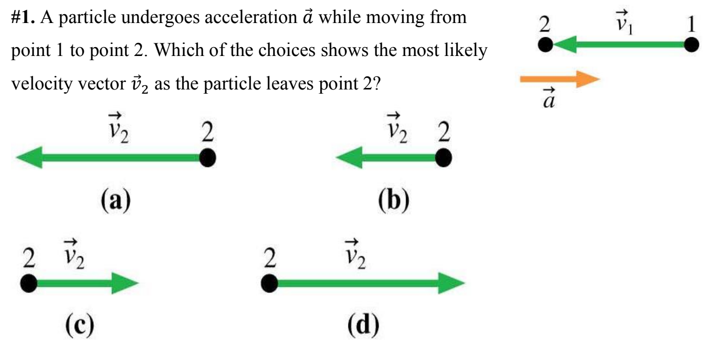
Stop To think 1.4, page 14

Slide 10
Example 1.5, Page 15

Slide 11
Assignment
Page 29-30, numbers 5-17 odds

